Slide 1
SMS Spam Detection
Contains the steps of Data Science Process for the project that is SMS Spam Detection

Slide 2
Group Members
Abdul Munim Khan (K15-2897)
Muhammad Moiz Arif (K15-2146)

Slide 3
Steps:
1. Read File
2. Print Different Stats (Plot, Describe Statistics…)
3. Download nltk library to remove stop wards
4. Split message words (on each space)
5. Remove stop wards
6. Now transform data into vector and fit data in it
7. Create data sparsity
8. Apply TF-IDF to find how important a word is to a document in a collection or corpus.
9. Apply MultinomialNB to word counts for text classification of discrete
10. Create simple Classification Matrix and Confusion Matrix
11. Train and Test our Systems
12. Put data in pipeline
13. Do Predictions
14. Show Stats
Notes:
It is easy to imagine that a vector which is representative of an entire language may contain thousands of words, however a document may only contain a few 100 words — and hence the vector will be predominately populated by many zeroes. This would be an example data sparsity.

Slide 4
Data Science 6 Steps
1. Research Goal
2. Retrieve Data
3. Data Preprocessing
4. Data Exploration
5. Data Modeling
6. Presentation & Automation

Slide 5
1. Introduction
The purpose of the project is to classify the text messages based on the prediction done by the trained model that is trained by the given dataset.

Slide 6
2. Research Goal
We are doing the message classification using as Spam or Ham that is the message is from legal sender or it’s a chain of same messages in order to just generate traffic on the targeted network or with some negative intention
P(y | x) = ( P(x | y) * P(y) ) / P(x) ----------- (i)
The probability of y given that the event x occurs.
We are using this law for spam classification as follows.
P (spam | W1, W2 ,W3) = ( P1 * P2 * P3 ) / ( P1 * P2 * P3 ) * (1 - P1) * (1 – P2) * (1 – P3).
The above formula is just elaboration of how we will predict the spam message after the training from dataset.
Notes:
. We will use Naïve Bayes algorithm for the text classification as it is the best algorithm used in textual analysis. The Naïve Bayes algorithm use the Bayes law which is stated following:

Slide 7
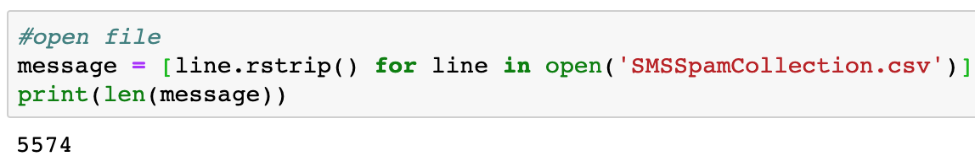
3. Retrieve Data
1
The data has been taken from the online dataset provider repository that is UCI Machine Learn- ing Repository. The dataset is present at the following link.
https://archive.ics.uci.edu/ml/ datasets/SMS+Spam+Collection#
Given Dataset has following properties:
Downloaded dataset has 5574 lines of messages

Slide 8
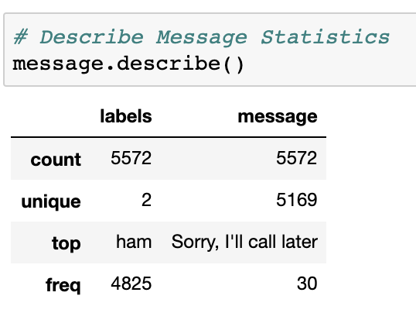
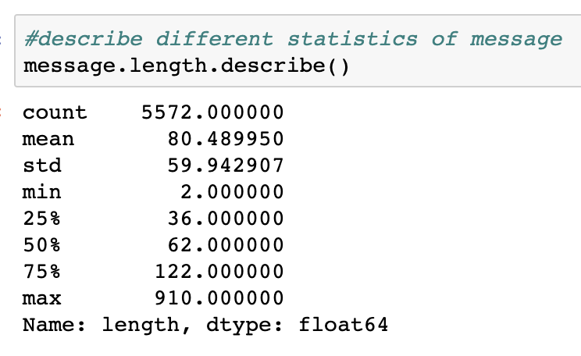
3. Retrieve Data
2
Our Dataset has total 5572 messages, having 2 unique labels
HAM and SPAM. Most of the messages are HAM.
Our dataset has following numeric values

Slide 9
4. Data Preprocessing
1
According to the UCI repository dataset information, the data is collected from different resources
and so it must need to be is particular order so that the model can be train from specified attributes
. Therefore, for data cleaning only the textual analysis involves so we removed the extra spaces from
the messages and those words that are not in the dictionary that is removal of slang words.

Slide 10
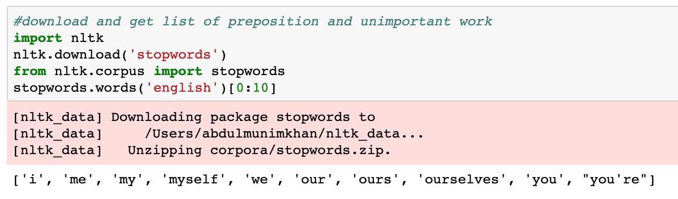
4. Data Preprocessing
2
We have downloaded nltk library to get dictionary of stopwards

Slide 11
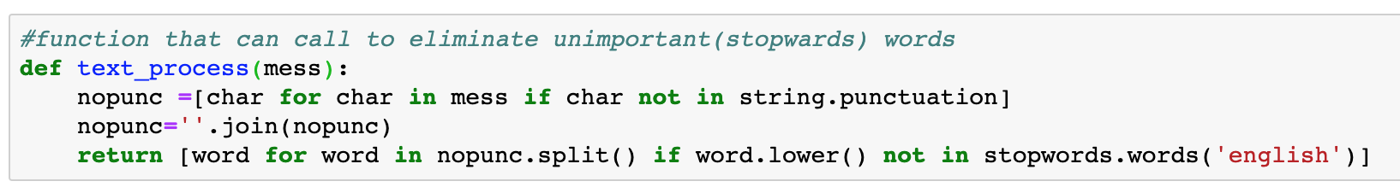
4. Data Preprocessing
3
text_process take string and remove unimportant words like stopwards

Slide 12
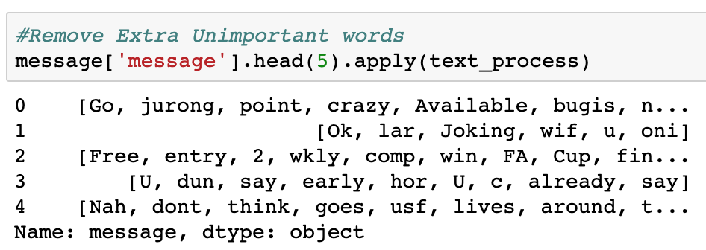
4. Data Preprocessing
3
After all process we got splitted text, excluded stopwards…

Slide 13
5. Data Exploration:
1
From figure below (747 * 100/ 5572 ) = 13.46% text messages from the given dataset are spam and the rest of the messages that is 86.54% of the messages are ham.
Also the messages are repeating (some messages), so the unique messages in both ham and spam are less than the total count.
The frequency of the most repeated text is thirty it means that the message ‘Sorry, I’ll call later’ arises thirty times in the messages.

Slide 14
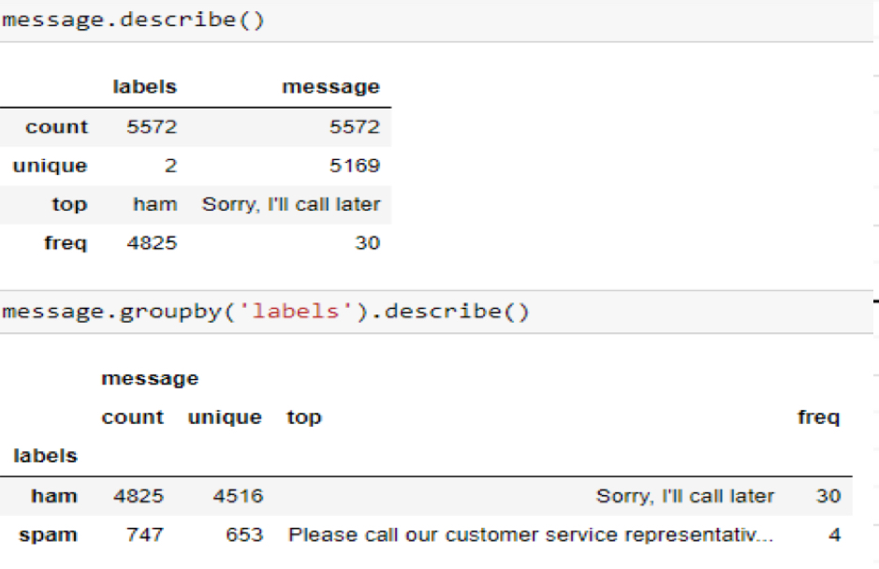
5. Data Exploration:
2
The frequency of the most repeated text is thirty it means that the message
‘Sorry, I’ll call later’ arises thirty times in the messages.

Slide 15
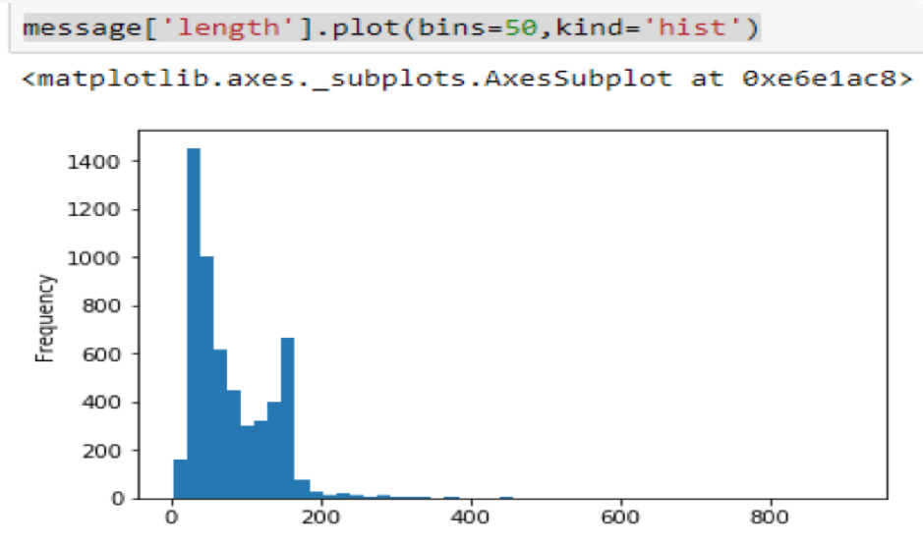
5. Data Exploration:
3
We have plotted graphs to show occurrence of text appearance.

Slide 16
6. Data Modeling
1
We have tokenize the data that is tokenize the messages into the list of words. Ex We have the message in the .csv file as ‘Ok lar joking wif u oni’. After tokenization this message becomes list of words as shown. [Ok, lar, joking, wif, u, oni].
Secondly, we tokenize the messages by stemming parts of speech. For Ex. In the above message given the wif is wife and u is you. Therefore replacing the correct word from its short. The results of the trained model are given as follows. The following fig showing the predicted and expected value of the message 3 in the dataset.

Slide 17
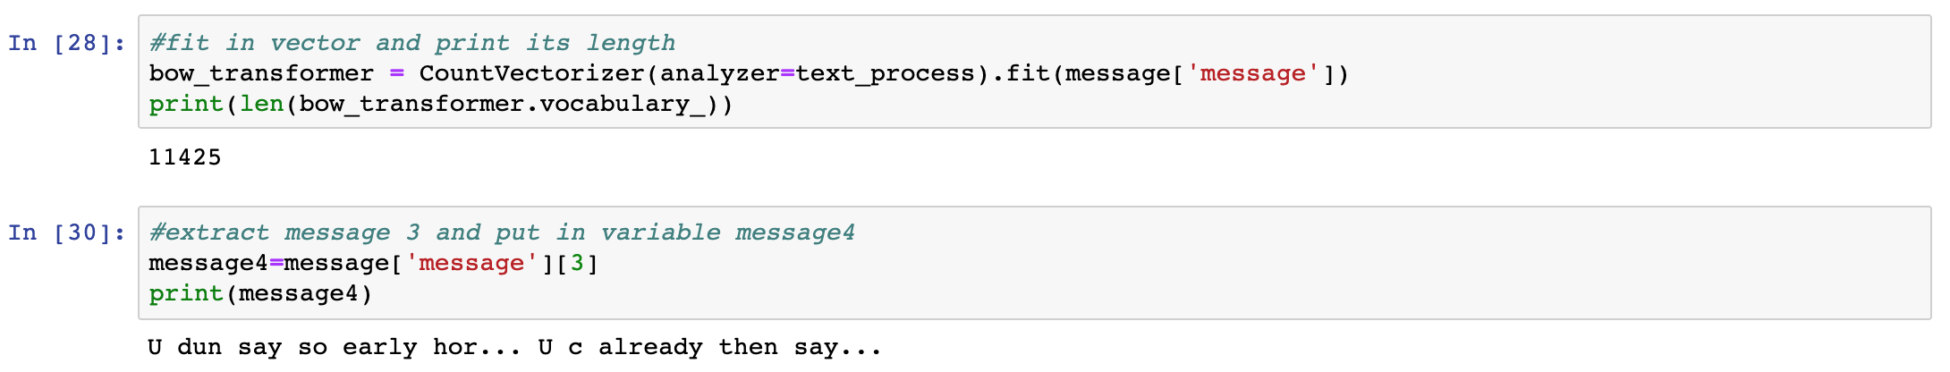
6. Data Modeling
2
As discuss we fit model into count vectorizer

Slide 18
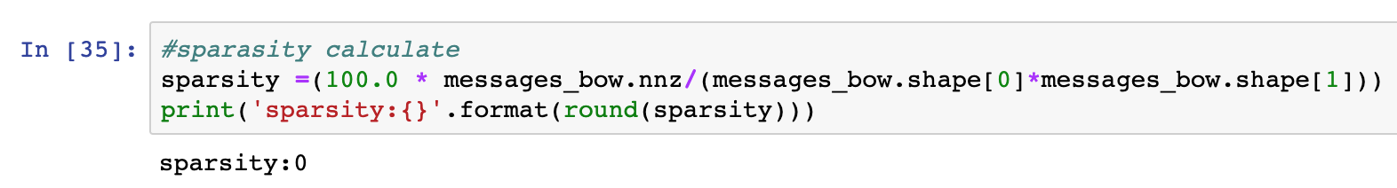
6. Data Modeling
3
We have find sparsity, because every message won’t contain all words in dictionary

Slide 19
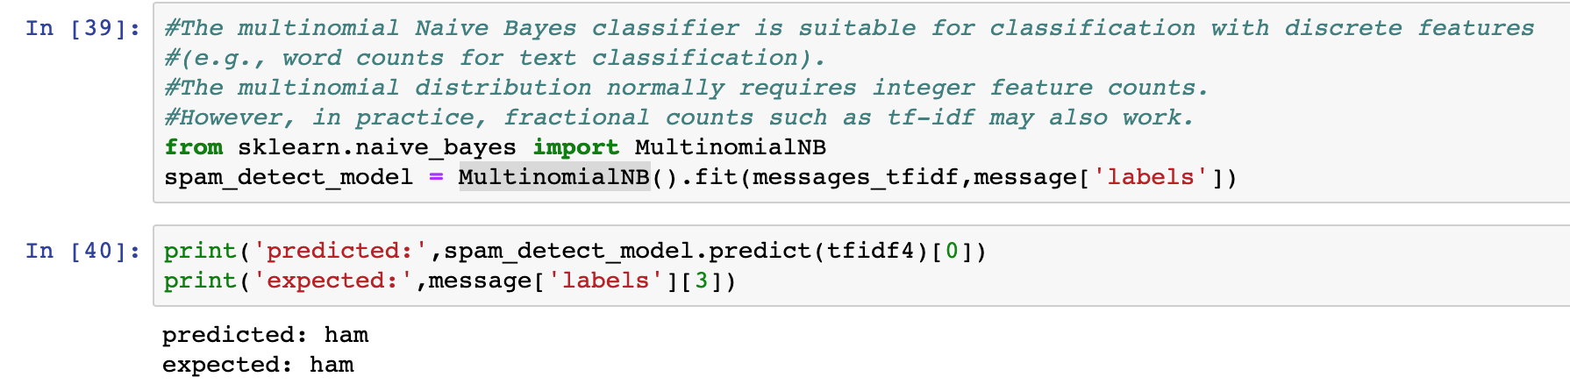
6. Data Modeling
4
We have fit data using MultinomialNB, and start predicting.

Slide 20
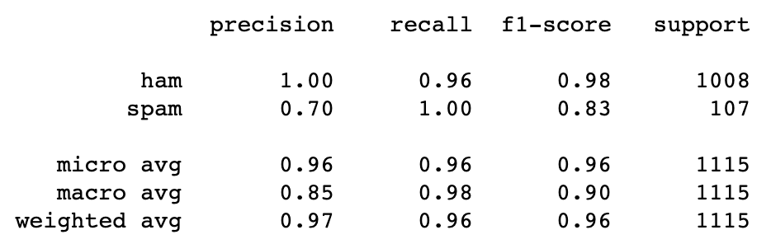
7.Presentation & Automation
Final Stats

